Slide 1
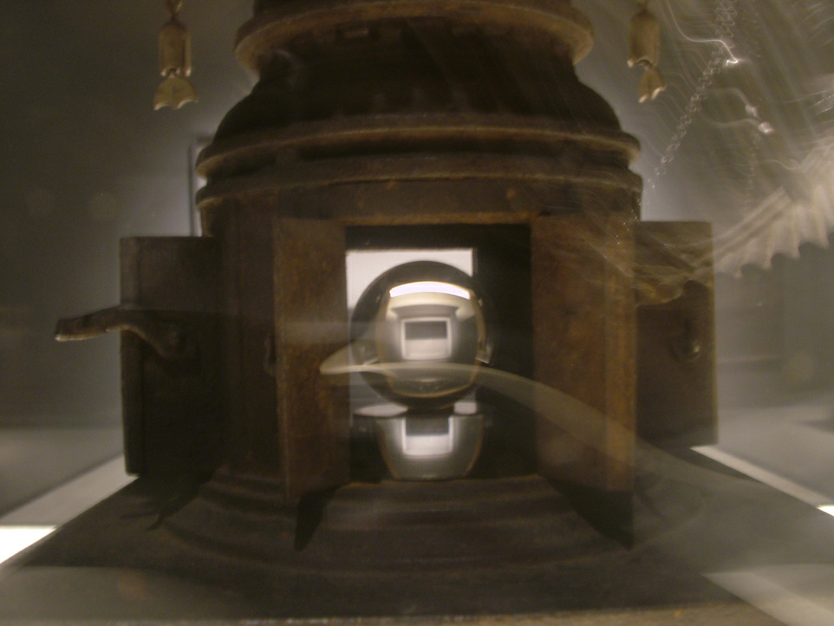
Unlocking your inner node.js with Windows Azure
Glenn Block - Microsoft
@gblock

Slide 2

This is me
@gblock

Slide 3

I work for this guy

Slide 4

And we work here
MICROSOFT

Slide 5

Actually no

Slide 6
Times have changed

Slide 7
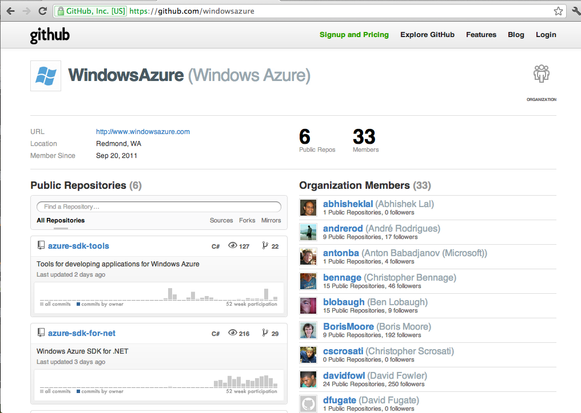

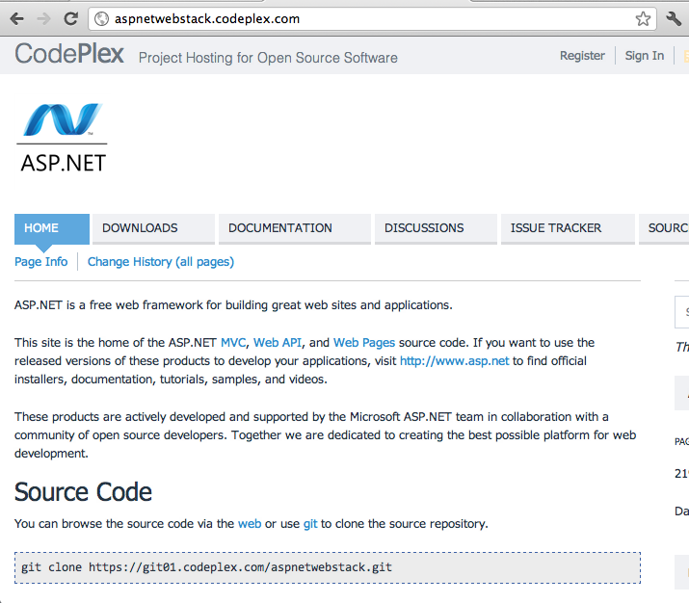
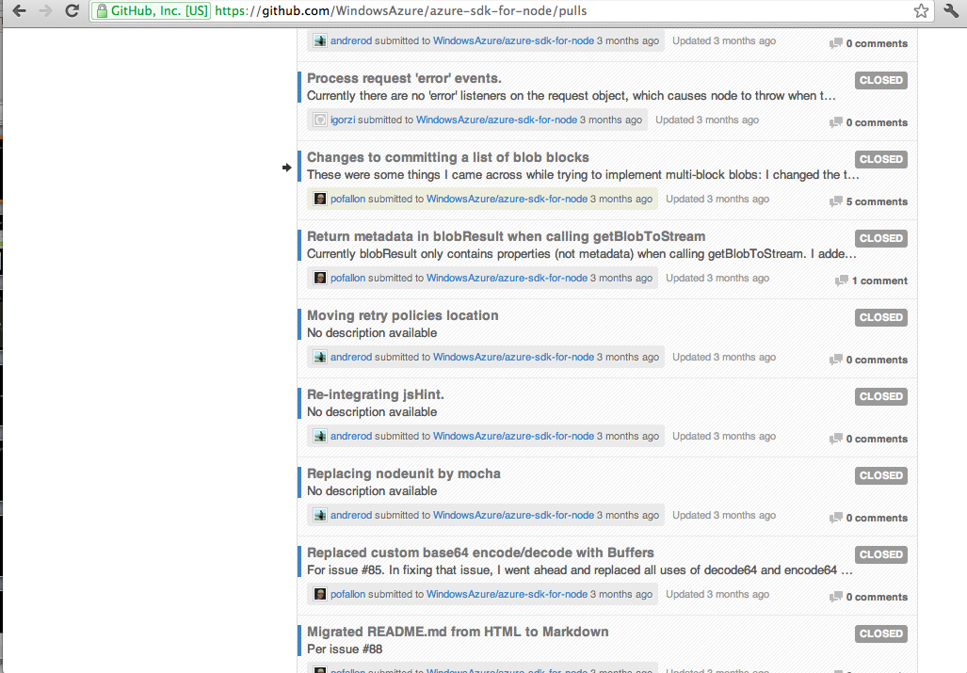
We’re digging open source

Slide 8
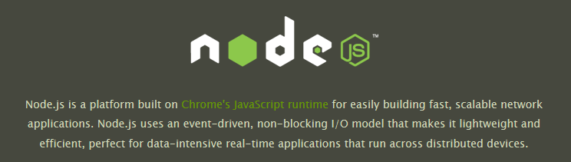
Notes:
http://www.flickr.com/photos/supertin/1368972764/sizes/l/in/photostream/

Slide 9
Why node?
Small
Fast
Scalable
Modular
Javascript

Slide 10




Who uses it?

Slide 11
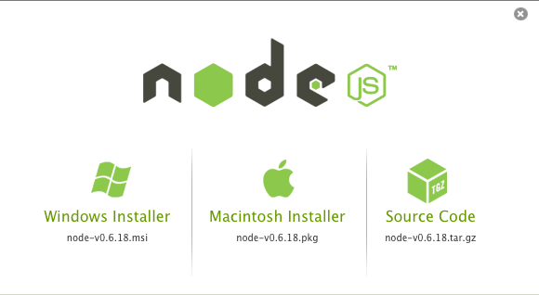
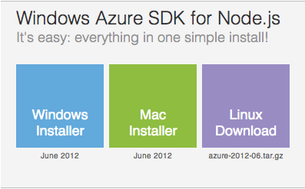
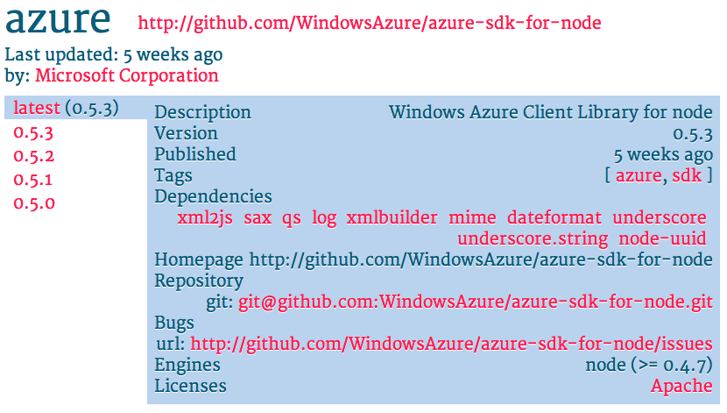
What we did

Slide 12
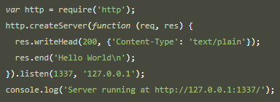

Slide 13


Slide 14
Windows Azure
Web Sites
VMs
Cloud Services

Slide 16


Slide 17
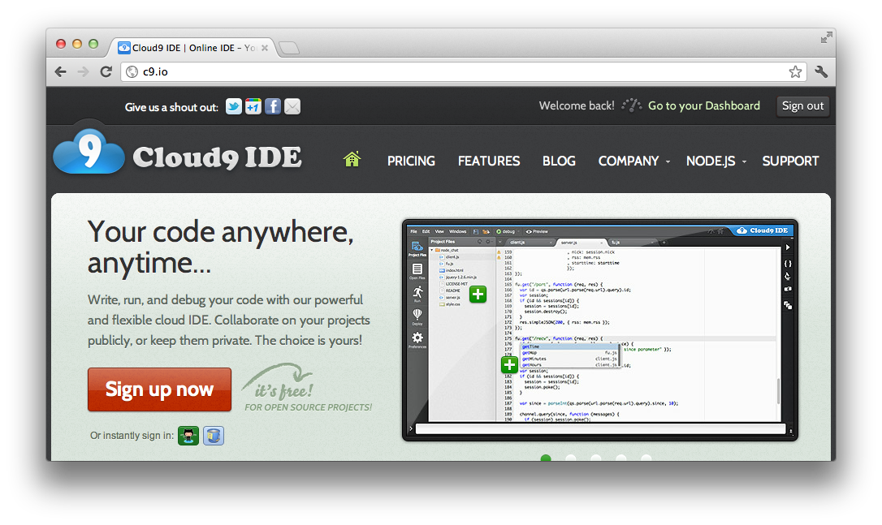

Slide 18
Links
http://nodejs.org – node.js site
http://bit.ly/azurenodedev – azure node center
http://npmjs.org – npm registry
http://expressjs.com – express
https://github.com/pofallon/node-bluesky – bluesky
http://github.com/iisnode - iisnode
http://github.com/dannycoates/node-inspector - node-inspector
Notes:
http://www.flickr.com/photos/sp8254/4915357604/sizes/l/in/photostream/
http://www.flickr.com/photos/supertin/1368972764/sizes/l/in/photostream/

